Slide 1
Classification of Numbers
Divisibility Rules
Simplification
L - 1

Slide 2
Classification of Numbers
  Detail classification of numbers
  Problem on types of Number(Integers, Natural, Even-Odd)
  Problem based on Prime Numbers
  Word Problem on Numbers
  Decimal to fraction Conversion
DIVISIBILITY Rules
  Division algorithm
  Divisibility Rules
  Problem on divisibility
  Data Sufficiency on related topic

Slide 3
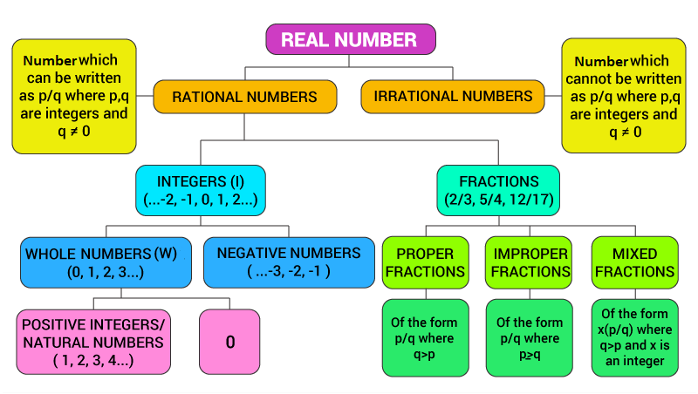
Classification of Numbers

Slide 4
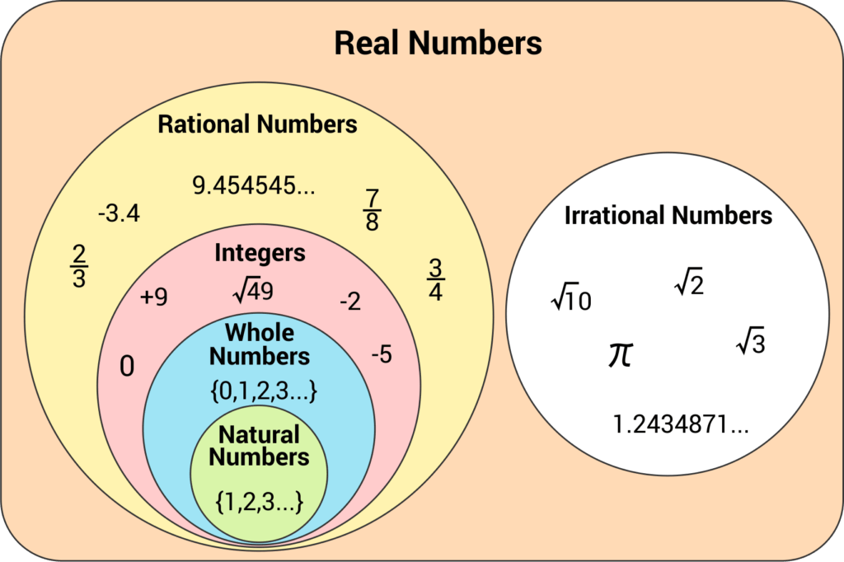
Classification of Numbers
Classification of Numbers

Slide 5
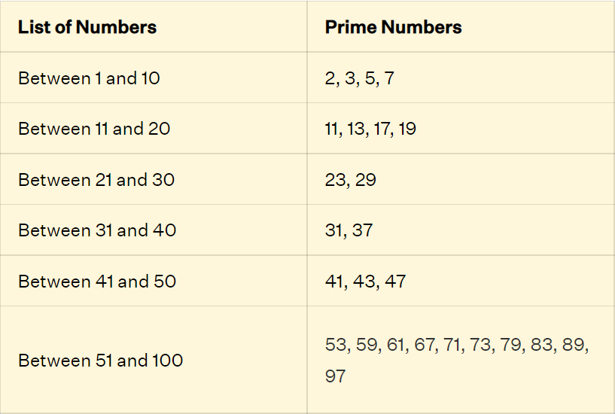
Classification of Numbers
Classification of Numbers
Prime Number:
A number greater than 1 with exactly two factors, i.e. 1 and the number itself is defined as a prime number.
There are 25 prime numbers from 1 to 100.

Slide 6
Properties of Prime Numbers:
There is only one even prime number, that is, 2.
Any two prime numbers are always co-prime to each other.
Every prime number, apart from 2 and 3, can be written in the form of '6n + 1 or 6n - 1’.
Composite Numbers:
Numbers greater than 1 having at least three factors.
Examples of composite numbers are 4, 6, 8, 9, 10, etc.
Coprime Numbers:
If a pair of numbers has no common factor apart from 1, then the numbers are called co-prime numbers.
Co-prime numbers can be prime or composite, the only criteria to be met is that the HCF of co-prime numbers is always 1.
Classification of Numbers

Slide 7
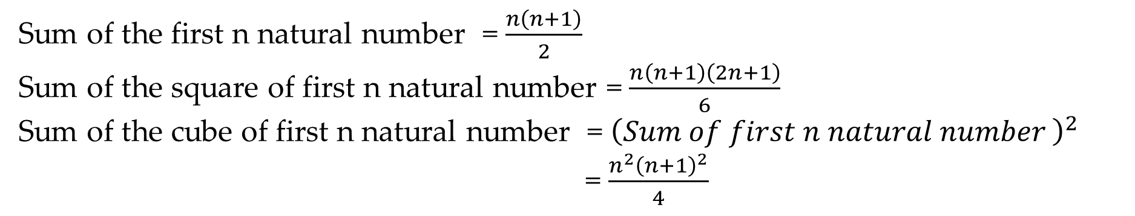
Classification of Numbers
Important Results related to some series:

Slide 8
Classification of Numbers
Q1. The sum of even numbers between 1 and 31is:
128 B) 198 C) 240 D) 188
Notes:
Difficulty level: Easy
Answer - C

Slide 9
Q2. If a and b are odd numbers, then which of the following is even?
A) a+b B) a+b+1 C) ab D) ab+2
Classification of Numbers
Notes:
Difficulty level: Easy
Answer - A
Compulsory

Slide 10
Classification of Numbers
Q3. The difference of the squares of two consecutive odd integers is divisible by which of the following integers?
A) 3 B) 8 C) 7 D) 6
Notes:
Difficulty level: Easy
Answer – B
Compulsory

Slide 11
Classification of Numbers
Q4. Find the sum of :2^2 + 4^2+6^2+….+20^2?
A) 1360 B) 1550 C) 1340 D) 1540
Notes:
Difficulty level: Moderate
Answer -D

Slide 12
Classification of Numbers
Q5. If x and y are two consecutive natural numbers than (-1)^x + (-1)^y is equals to:
a) 2 b) -2 c) 0 d) 1
Notes:
Difficulty level: Moderate
Answer – C
Compulsory

Slide 13
Classification of Numbers
Q6. x, y and z are prime numbers and x + y + z = 38. What is the maximum value of x?
a) 29 b) 31 c) 23 d) 17
Notes:
Difficulty level: Moderate
Answer- B
Compulsory

Slide 14
Classification of Numbers
Q7. When the sum of four consecutive two-digit odd numbers divided by 10, the result obtained is a perfect square. Which of the following can possibly be one of these four numbers?
A) 39 B) 47 C) 67 D) 21
Notes:
Difficulty Level: Moderate
Answer -A

Slide 15
Classification of Numbers
Q8. Sum of three fractions is 2(11/24). On dividing the largest fraction by the smallest fractions, 7/6 is obtained which is 1/3 greater than the middle fractions. The smallest fractions is
A) 3/4 B) 3/7 C)5/8 D) 5/6
Notes:
Difficulty Level: Moderate
Answer – A
Compulsory

Slide 16
Classification of Numbers
Q9. If the sum of two numbers is 42 and their product is 437, then find the difference between the numbers?
A) 12 B) 5 C) 4 D) 9
Notes:
Difficulty Level: Moderate
Answer - C

Slide 17
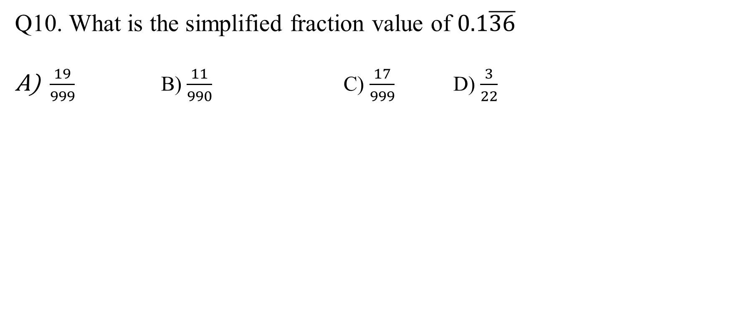
Classification of Numbers
Notes:
Difficulty Level: Moderate
Answer: D
Compulsory

Slide 18
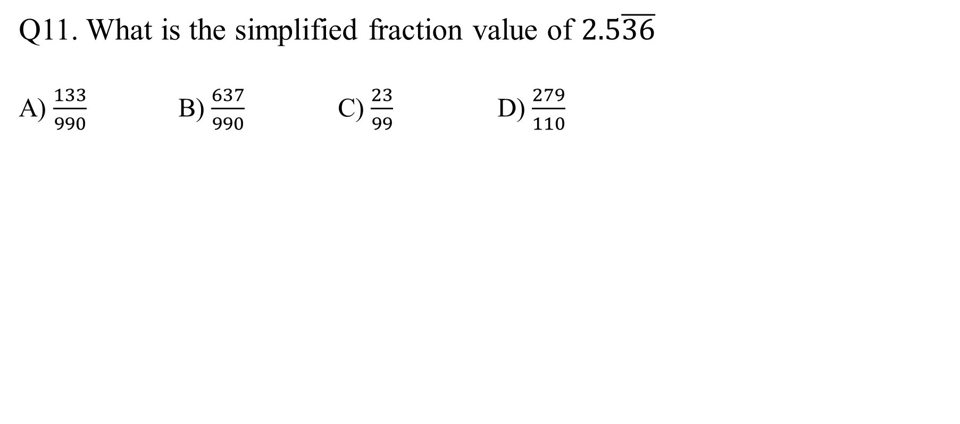
Classification of Numbers
Notes:
Difficulty Level: Moderate
Answer: D
Compulsory

Slide 19
Classification of Numbers
Q12. The number x = 1.24242424….. can be expressed in the form x = p/q, where p and q are positive integers having no common factors. Then the value of p + q is
A) 76 B) 72 C) 74 D) 222
Notes:
Difficulty Level: Moderate
Answer: C
Compulsory

Slide 20
Division Algorithm
1) If a and b are integers ; b>0
then there exist unique integer q and r satisfying
a=qb+r; 0≤ r ≤ b
where q and r are called quotient and remainders in the division of a by b.
2) If a and b are integers ; b<0
then there exist unique integer q and r satisfying
a=qb+r; 0≤ r ≤ |b|
where q and r are called quotient and remainders in the division of a by b.

Slide 21
Division Algorithm :Practice Questions
Q13. In a division problem, the divisor is 6 times the quotient and 3 times the remainder. If remainder is 40, then the dividend is
A) 2440 B) 2430 C) 2624 D) 2524
Notes:
Difficulty Level: Moderate
Answer – A
Compulsory

Slide 22
Division Algorithm :Practice Questions
Q14. A number when divided by 2736, leaves remainder 75. If the same number is divided by 24, the remainder will be
A) 3 B) 2 C) 1 D) 0
Notes:
Difficulty Level: Moderate
Answer-A
Compulsory

Slide 23
Divisibility rules of 2,4,8
2 – Last digit is even (0,2,4,6,8)
4- Last two digits are divisible by 4 (124, 123456, 23468)
8- Last three digits are divisible by 8 (123488, 1234888)

Slide 24
Divisibility rules of 3, 9
3 – Sum of the digits is divisibly by 3
9 – Sum of the digits is divisible by 9
Divisibility rule of 6:
If a number is divisible by 2 and 3,it is divisible by 6
Divisibility rule of 6

Slide 25
Divisibility rule of 6
Ex: 246
a.2+4+6= 12, 12 is divisible by 3,so 246 is divisible by 3
b.246 ends in 6,so 246 is divisible by 2
246 is divisible by 2 and 3 .so 246 is divisible by 6

Slide 26
Divisibility rule of 7
Take the last digit and double it, subtract that from the remaining digits, continue until you get a number that is divisible by 7.
Example: 442
Take the last digit and double it, 2*2 = 4
44 – 4 = 40
Is 40 a multiple of 7?No, hence , 442 is not divisible by 7

Slide 27
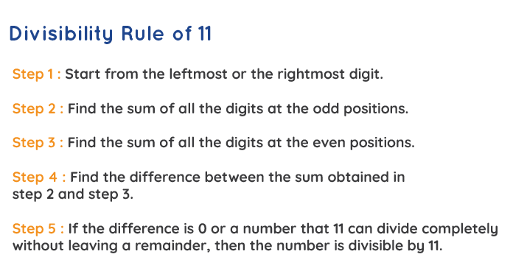
Divisibility rule of 11
A shortcut to check for the numbers divisible by 11 is by adding the numbers in even and odd places and subtracting the two sums. If the difference is a multiple of 11, then divisibility by 11 is proved.
Example: 1331
(1+3) – (1+3) = 0
Therefore number is
divisible by 11

Slide 28
Divisibility rules of Prime Numbers: 13
Take the last digit and multiply by 4 , Add the product to the rest of the number
Example: 442
Take the last digit and multiply it by 4, 2*4 =8
44 + 8 = 52
Is 52 a multiple of 13? Yes, hence ,442 is divisible by 13.

Slide 29
Divisibility rules of Prime Numbers: 17
Take the last digit and multiply by 5 , Subtract the product to the rest of the number
Example: 15181
Take the last digit and multiply it by 5, 1*5 =5
1518- 5 = 1513
Take the last digit again and multiply it by 5, 3*5 =15
151-15=136
Is 136 a multiple of 17? Yes, hence ,15181 is divisible by 17.

Slide 30
Divisibility Rules: Practice Questions
Q16. If the number 517?324 is completely divisible by 3,then the smallest whole number in place of ? will be:
A] 5 B] 3 C] 2 D] 8
Notes:
Difficulty Level: Easy
Answer – C
Compulsory

Slide 31
Divisibility Rules: Practice Questions
Q17. If the number 23P62971335 is divisible by the smallest, odd composite number, then what is the value of P?
A. 4 B. 5 C. 7 D. 8
Notes:
Difficulty Level: Easy
Answer-A
Compulsory

Slide 32
Divisibility Rules: Practice Questions
Q18. The smallest number, which should be added to 756896 so as to obtain a multiple of 11, is?
A) 1 B) 3 C) 5 D) 8
Notes:
Difficulty Level: Moderate
Answer- B
Compulsory

Slide 33
Divisibility Rules: Practice Questions
Q19. If x and y are the two digits of the number 653xy such that this number is divisible by 80, then x+y is equal to ?
A) 6 B) 5 C) 8 D) 10
Notes:
Difficulty level: Moderate
Answer – A
Compulsory

Slide 34
Divisibility Rules: Practice Questions
Q20. A 3-digit number 5a3 is added to another 3-digit number 714 to give a 4-digit number 12b7, which is divisible by 11. Then, (a + b) = ?
A) 12 B) 15 C) 8 D) 20
Notes:
Difficulty level: Difficult
Answer – B
Compulsory

Slide 35
Divisibility Rules: Practice Questions
Q 21. The given no 446673877 is divisible by which of the following no?
A) 7only B) 13only C) Both 7 and 13 D) None
Notes:
Difficulty level: Moderate
Answer - B

Slide 36
Divisibility Rules: Practice Questions
Q22. There is a 36- digit number consist of only one digit from 1,2,3,4,5,6,7,8 …e.g. 5555…………555, 77777…….77. Such number is always divisible by:-
A) 7 B) 11
C) 13 D) All of the above
Notes:
Difficulty Level: Difficult
Answer – D
Compulsory

Slide 37
Divisibility Rules: Practice Questions
Q23. A number 15015 is divisible by
A)7 &11 both B) 11 &13 both C) 7 & 13 both D) All 7,11,13
Notes:
Difficulty level: Moderate
Answer - D

Slide 38
Divisibility Rules: Practice Questions
Q24. A 12-digit number is formed by repeating a three-digit number; for example, 202202202202 or 978978978978 etc. Any number of this form is always exactly divisible by:
A) 11 B) 13 C) 1001 D) All of these
Notes:
Difficulty level: Difficult
Answer – D
Compulsory

Slide 39
Divisibility Rules: Practice Questions
Q25. Which digit should come in the place of * and # if the number 62684*# is divisible by both 8 and 5 ?
A) 4 and 0
B) 0 and 5
C) 5 and 0
D) 2 and 0
Notes:
Difficulty level: Moderate
Answer – A

Slide 40
Divisibility Rules: Practice Questions
Q26. What smallest number should be added to 4456 so that the sum is completely divisible by 6 ?
0
3
2
1
Notes:
Difficulty level: Easy
Answer – 2

Slide 41
Divisibility Rules: Practice Questions
Q27. What is that least number that should be added to 478 so that the number obtained becomes exactly divisible by 5, 6 and 24?
62
12
2
8
None of the above
Notes:
Difficulty level: Difficult
Answer – Option 3 : 2

Slide 42
Divisibility Rules: Practice Questions
Q28. Let XYZ be a 3-digit number. Let S = XYZ + YZX + ZXY. Which of the following statements is/are correct?
1. S is always divisible by 3 and (X + Y + Z)
2. S is always divisible by 9
3. S is always divisible by 37
Select the correct answer using the code given below:
1 only
2 only
1 and 3
More than one of the above
None of the above
Notes:
Difficulty level: Difficult
Answer – 3 : 1 and 3
Compulsory

Slide 43
Data Sufficiency: Classification of Numbers
Directions(29-30): In each of the questions below consists of a question and two statements numbered I and II given below it. You have to decide whether the data provided in the statements are sufficient to answer the question. Read both the statements and
Give answer
(A) If the data in statement I alone are sufficient to answer the question, while the data in statement II alone are not sufficient to answer the question
(B) If the data in statement II alone are sufficient to answer the question, while the data in statement I alone are not sufficient to answer the question
(C) If the data either in statement I alone or in statement II alone are sufficient to answer the question
(D) If the data given in both statements I and II together are not sufficient to answer the question and
(E) If the data in both statements I and II together are necessary to answer the question

Slide 44
Data Sufficiency: Classification of Numbers
Q29. What is the two-digit number?
i) The difference between the two digits is 9.
ii) The sum of the digits is equal to the difference between the two digits.
Notes:
Difficulty level: Moderate
Answer: A

Slide 45
Data Sufficiency: Classification of Numbers
Q30. Is the positive integer X divisible by 21?
i) When X is divided by 14, the remainder is 4
ii) When X is divided by 15, the remainder is 5
Notes:
Difficulty level: Moderate
Answer: C
Compulsory

Slide 46
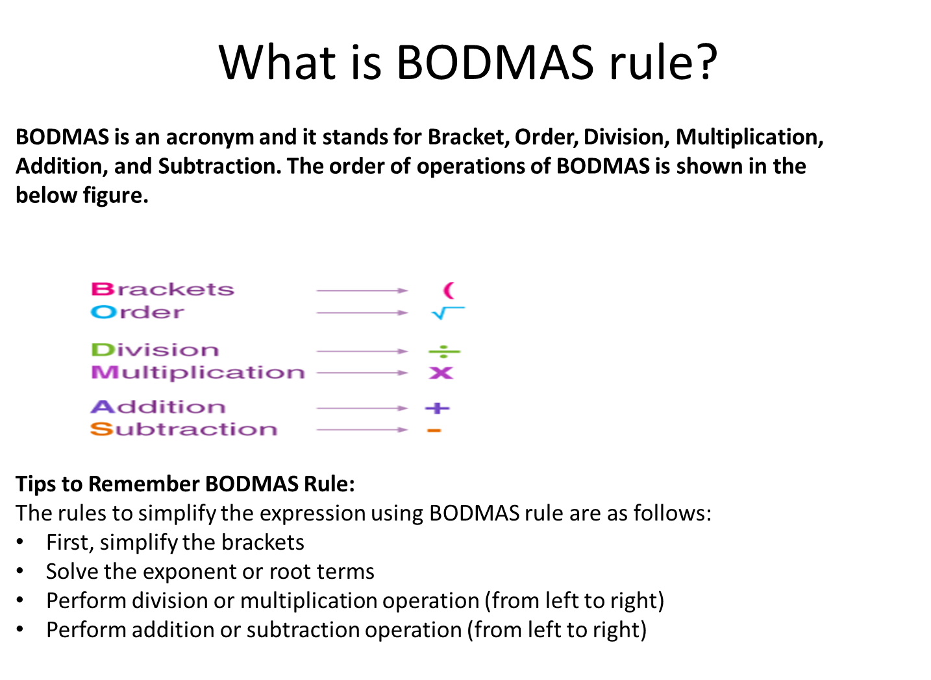
Simplification
Notes:
Difficulty level: Moderate
Answer: C
Compulsory

Slide 47
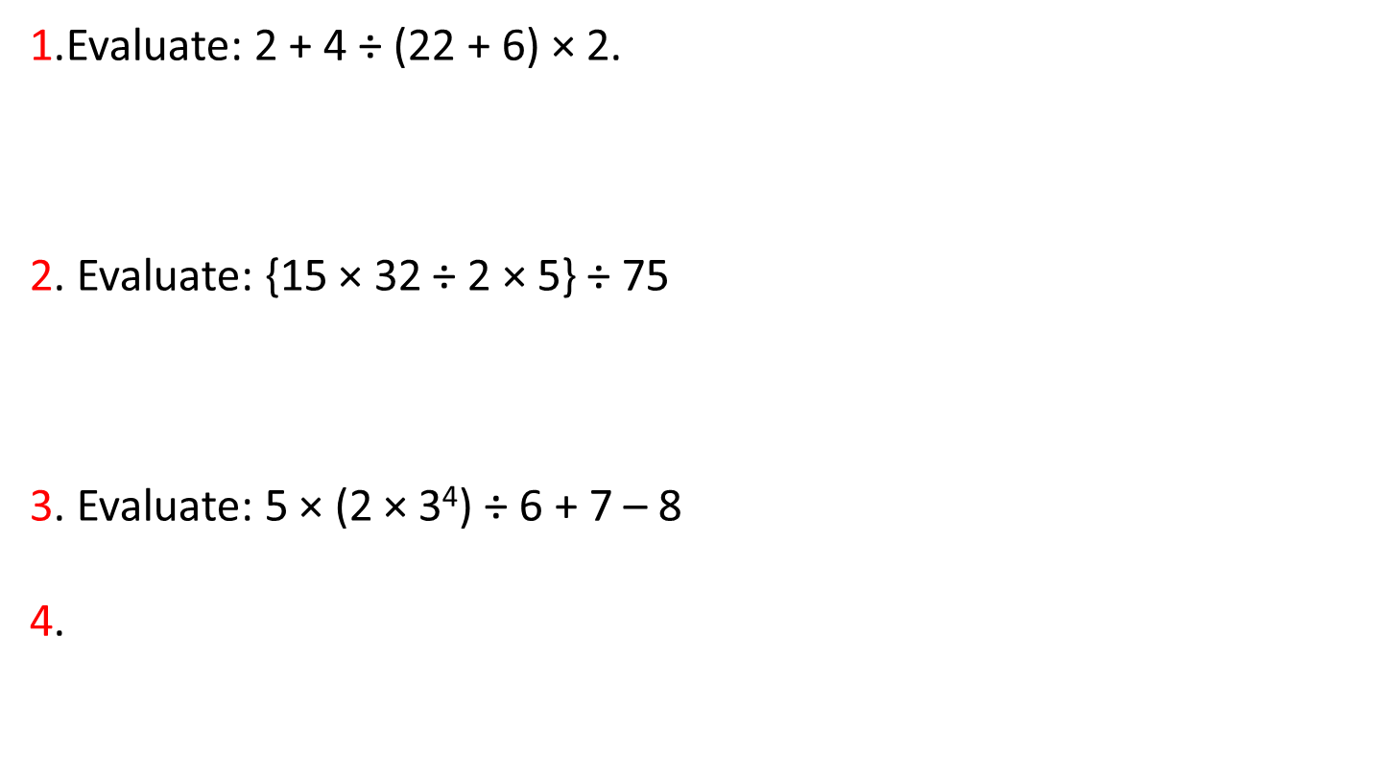
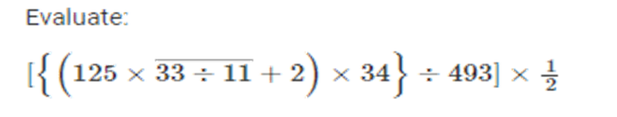
Simplification
Notes:
Difficulty level: Moderate
Answer: C
Compulsory

Slide 48
Simplification
5. 58 x 96 x 62 =?
(a) 345246 (b) 345226 (c) 345216 (d) 345236
6. 2387-123+980=?-145+945
2244 (b)2434 (c)2444 (d)2544
Notes:
Difficulty level: Moderate
Answer: C
Compulsory

Slide 49
Simplification
7. 175 × 28 + 275 × 27.98 = ?
(a) 11800 (b) 12600 (c) 12800 (d) 11600 (e) 16200
8. 324.995 × 15.98 ÷ 4.002 + 36.88 = ?
(a) 1300 (b) 1230 (c) 1340 (d) 1380 (e) 1390
Notes:
Difficulty level: Moderate
Answer: C
Compulsory

Slide 50
Simplification
9. 63.5% of 8924.2 + ?% of 5324.4 = 6827.5862
36 (b) 52 (c) 13 (d) 21 (e) 41
10. 67% of 801 – 231.17 = ? – 23% of 789
(a) 490 (b) 440 (c) 540 (d) 520 (e) 590
Notes:
Difficulty level: Moderate
Answer: C
Compulsory

Slide 51
Any Doubts???

